Slide 1













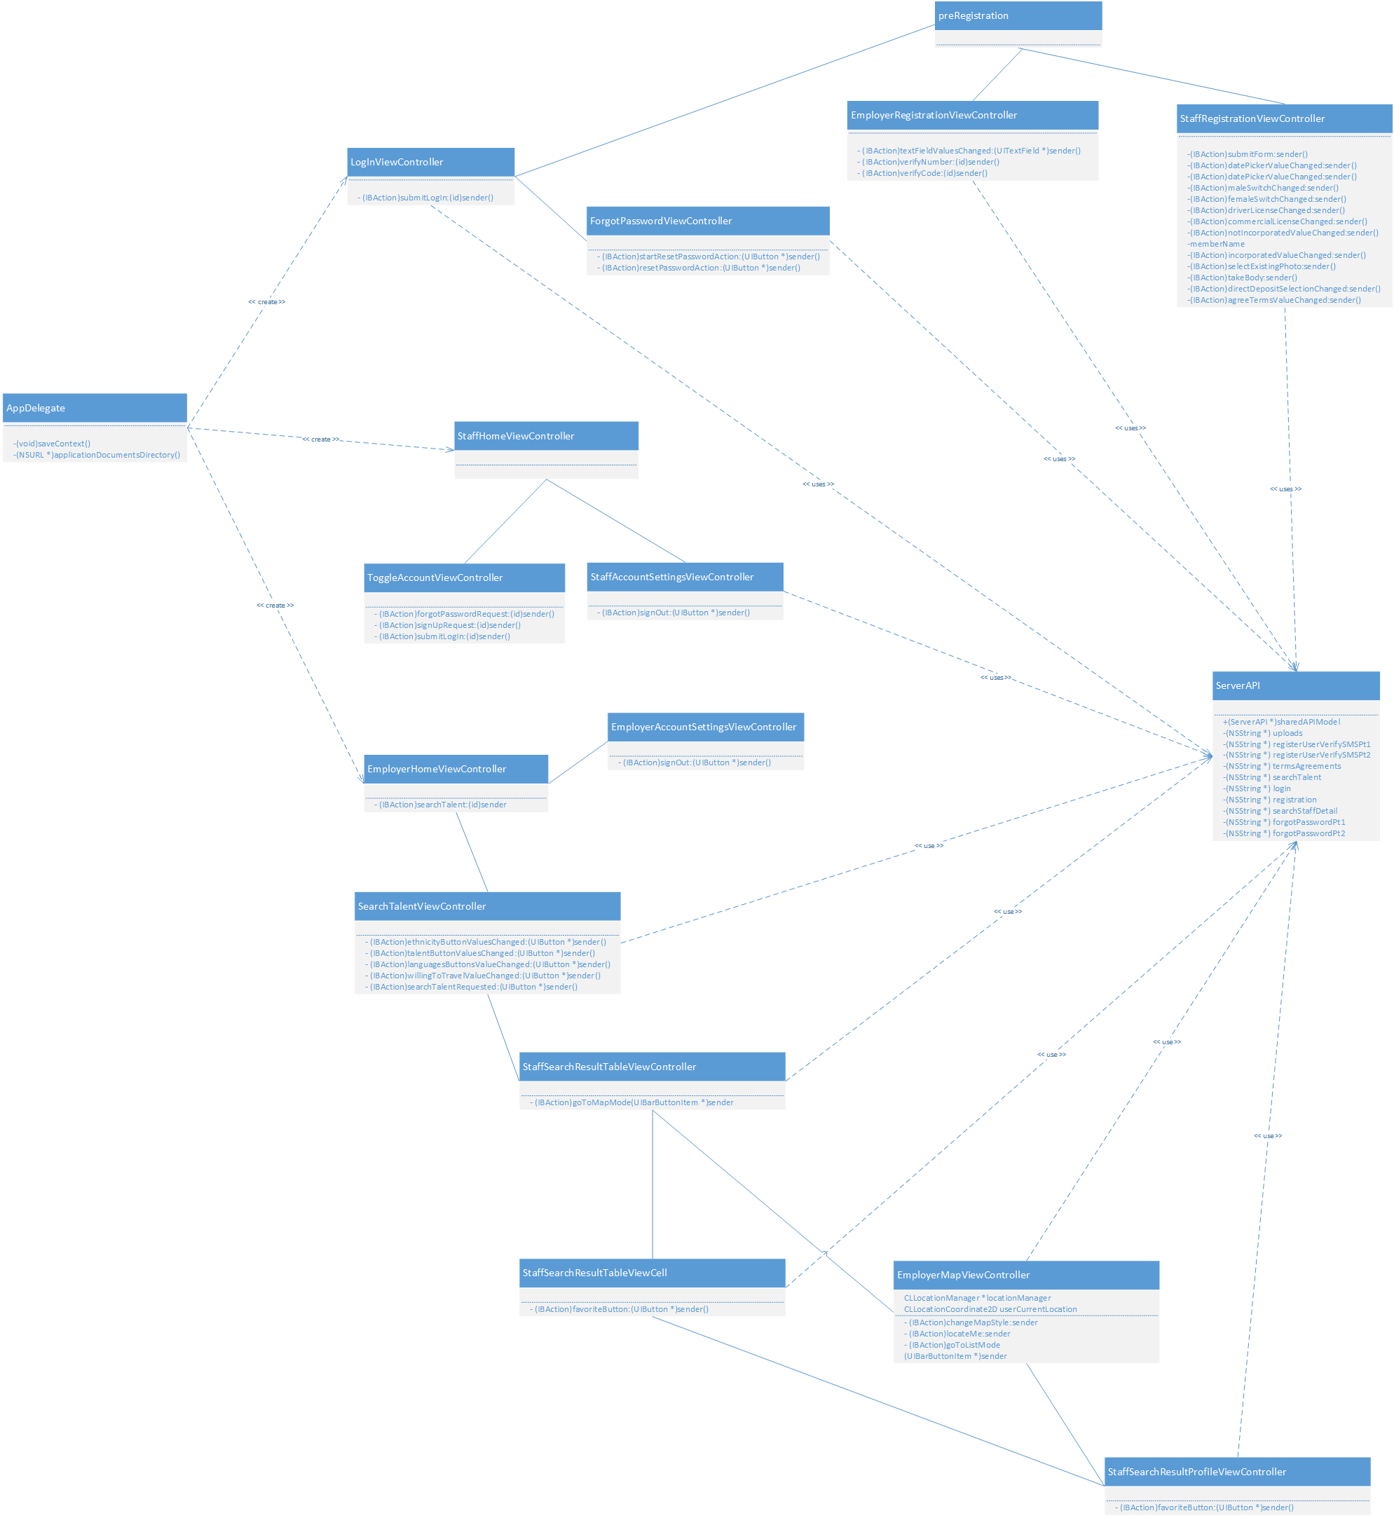
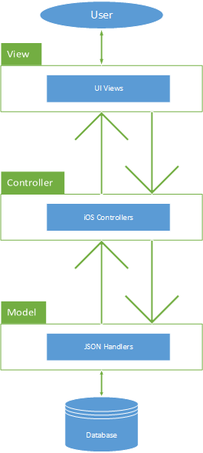
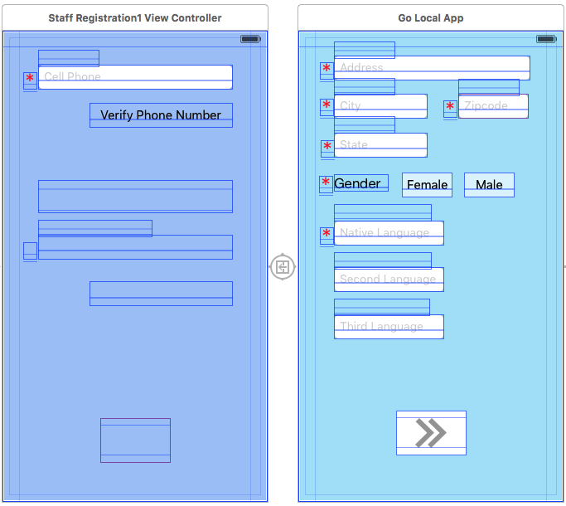
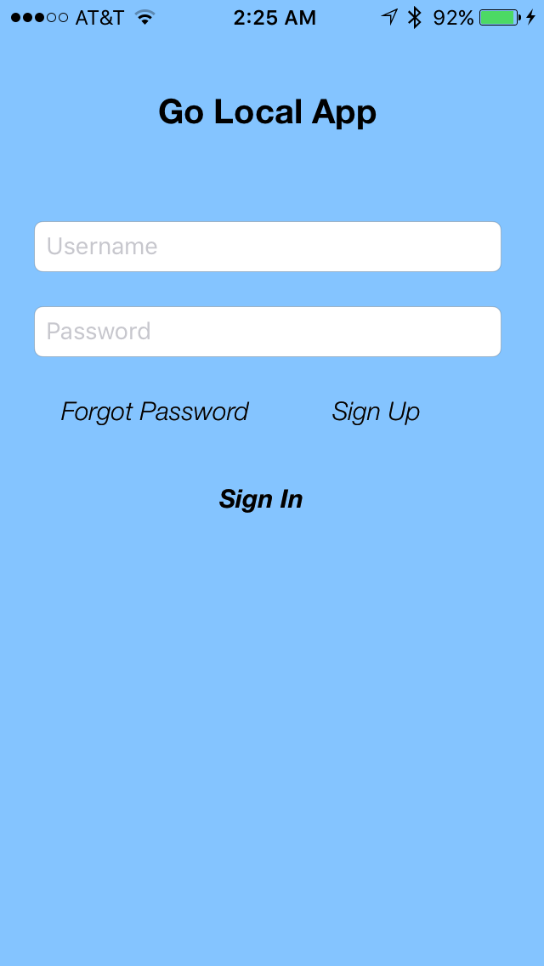

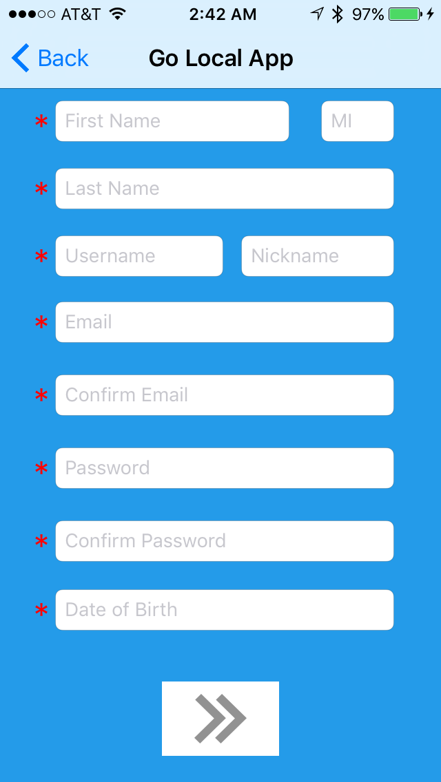
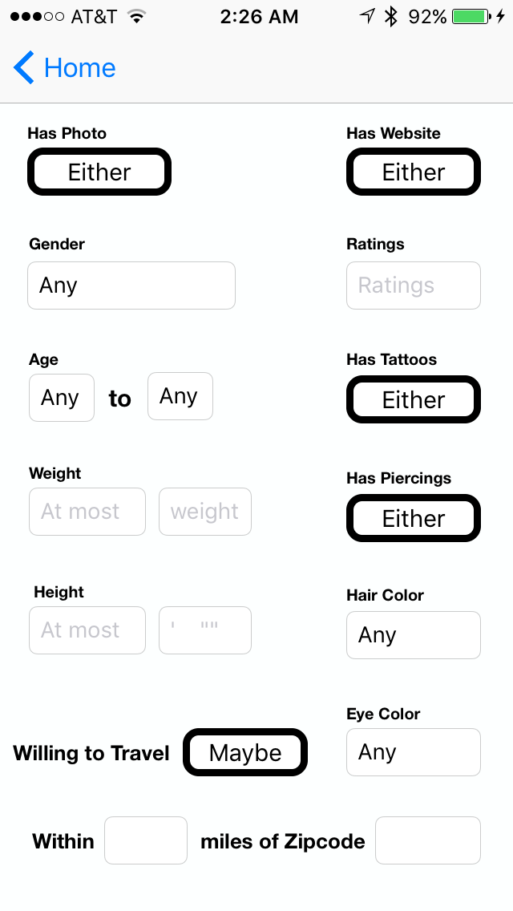
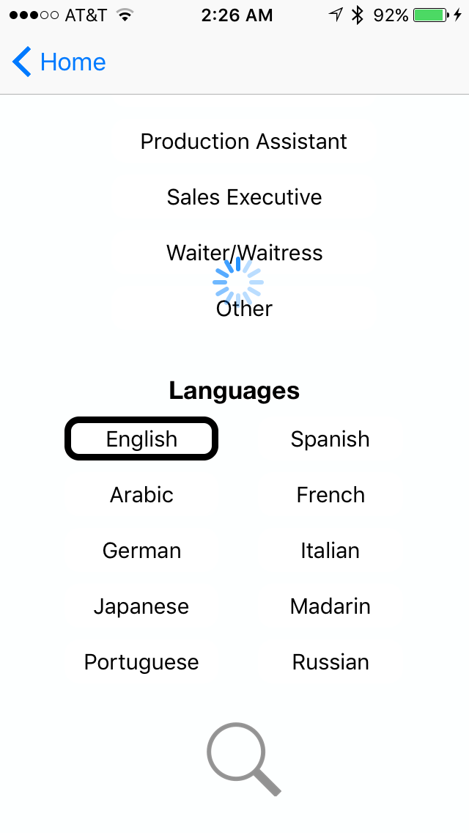
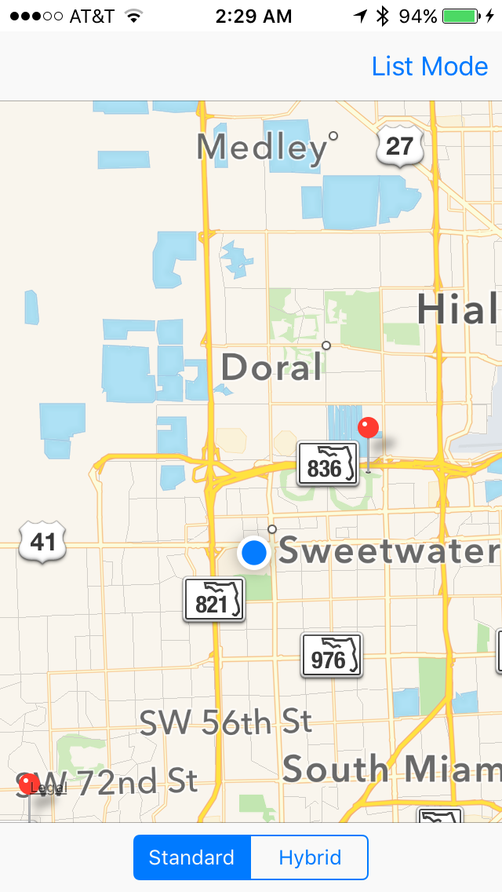
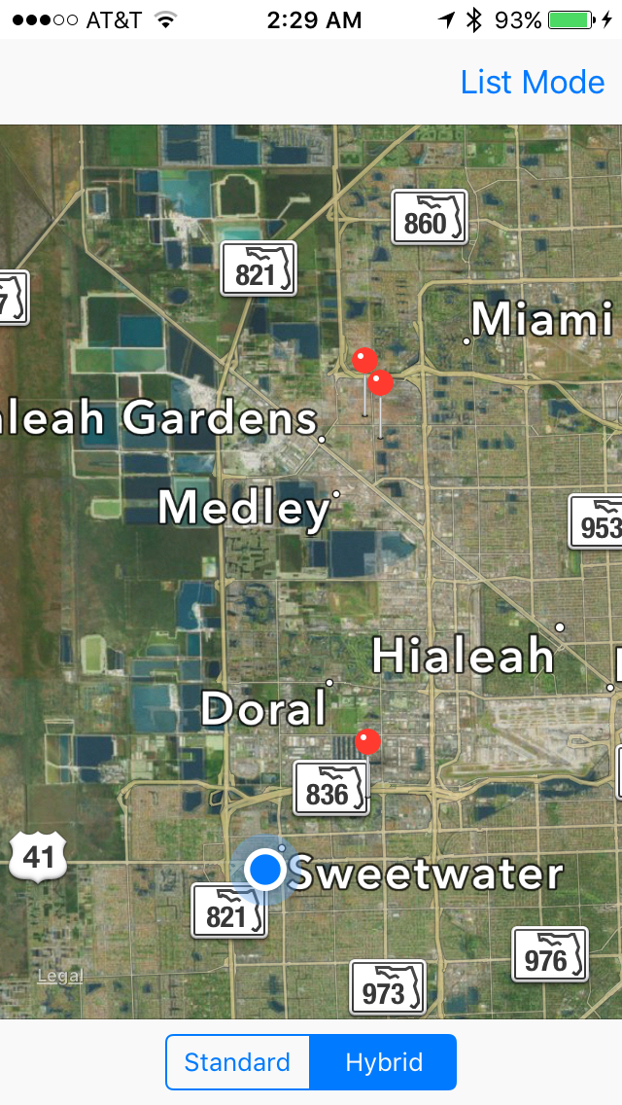
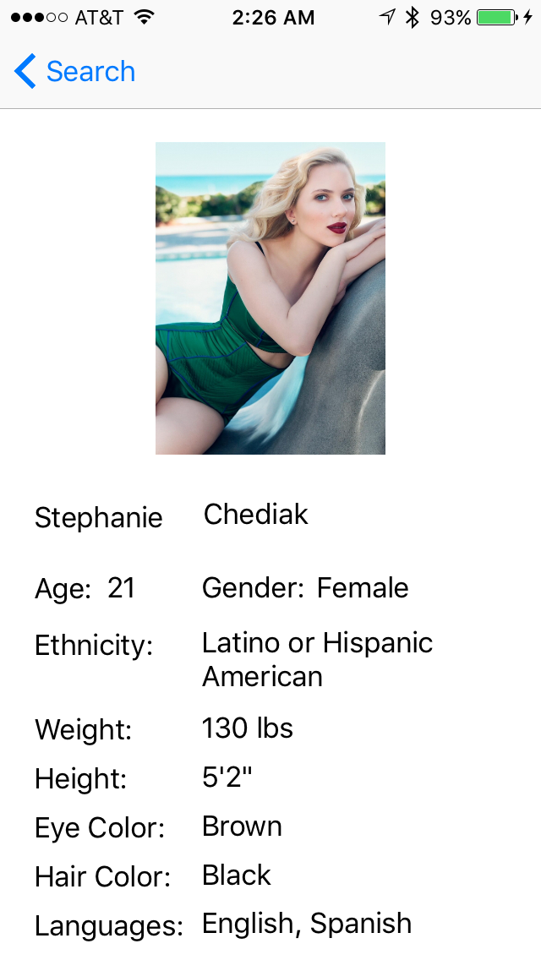
School of Computing & Information Sciences
Senior Project, 2015, Fall
Go Local Staff App
Student: Luis Castillo, Florida International University
Mentor: Eduardo Garcia, Go Local Promotions
Instructor: Masoud Sadjadi, Florida International University
Problem
Current System
Requirements
The current promotional staff and event organizers are limited by staffing agencies in the following manner:
High overhead expenses
Limited number of talent
Sufficient planning required to execute events
Not only will these problems be resolve by a mobile application, but it will also create a community of marketers willing to work for reasonable wages.
Event organizers and staff talent currently connect through intermediate staffing agencies. These staffing agencies, have a limited number of talents registered in their network. Therefore, event organizers are forced to search for talents in other agencies.
Moreover, the agencies are strict in the hours they operate and communicate with the staff talents or event organizers. These limitations in communication affect unforeseen changes or needs in behalf of the talent organizer. Due to the lack of communication, if staff is unable to make it to an event or the organizer is in need of additional talent, at the last time before a special event, it is difficult to make adjustments.
The system should allow
unregistered users to create an account as staff talent or employer
users to log in and log out
users to toggle or switch between their accounts
employers to search for staff based on specific talent requirements
employers to view the talent information
employers to display talent around their current location in a map
management users to see the total registered users along with their qualifications
store and retrieve information from a server
Object Design
System Design
Implementation
The system is implemented with a Model-View-Controller.
The system is implemented with a Model-View-Controller design, using Objective-C, JSON and PHP.
The system uses a Linux, Apache, MySQL and PHP server configuration hosted on DigitalOcean.
An API was created in the server to handle JSON POST request from the mobile application, to facilitate securely and efficiently the communication between the server and mobile application.
Verification
Summary
To verify the user’s phone number during
registration, the app connects to the web server
using a JSON POST form and the Linux server
sends the user a text message to the number provided with a unique four digit code.
After the phone has been verified a ‘continue’ button appears so the user can move on to the next step.
Manual testing was used to test the different components of the system. Some of these components consisted of JSON formatting errors, networks errors, iOS State loading. The purpose of our testing was to make sure that the system was behaving appropriately.
The Goal of our project is to facilitate the financial burden and drawbacks of using staffing agencies. The Application that my group member and I created allows event organizers to connect to a broader network of staff talents at a moment notice and with the hefty fees from staffing agencies.
Screenshots
Acknowledgement
The material presented in this poster is based on the work supported by Eduardo Garcia and Sadjadi Masoud. I am thankful for the help I received from my group member, Wilfredo Gomez, and friends. I am especially grateful for my family’s support.

